Slide 1
Employee salary prediction using STREAMLIT
Presented By:
Name: Kommula Hemasree
College Name: Malla Reddy Engineering College for Women’s
Branch: CSE(AIML)

Slide 2
OUTLINE:
Problem Statement
System Development Approach
Algorithm & Deployment (Step by Step Procedure)
Result
Conclusion
Future Scope
References

Slide 3
Problem Statement
Objective: Develop a machine learning model to predict employee salaries based on age, gender, qualification, job role, and years of experience.
Motivation: Help HR teams and job seekers make data-driven decisions regarding fair and competitive salary estimates.
Data Input: User-provided features such as age, gender, qualification, job role, and experience.
Solution Approach: Train a regression model (Random Forest) using preprocessed historical salary data and deploy it as an interactive Streamlit web app.
Expected Output: A real-time predicted salary (in ₹) based on the provided inputs.

Slide 4
System Approach
System requirements
Python
IDE/Editor
Web Framework
Browser
Library required to build the model
pandas, numpy
scikit- learn
joblib
streamlit

Slide 5
Algorithm & Deployment
Algorithm (Step-by-Step Workflow)
Load the Data
Preprocess the Data
Model Training
Build Stramlit UI
Test and Save the Model

Slide 6
Deployment:
Local Deployment:
Save code in app.py
Open terminal and run : streamlit run app.py
App runs
Deploy on Streamlit Cloud

Slide 7
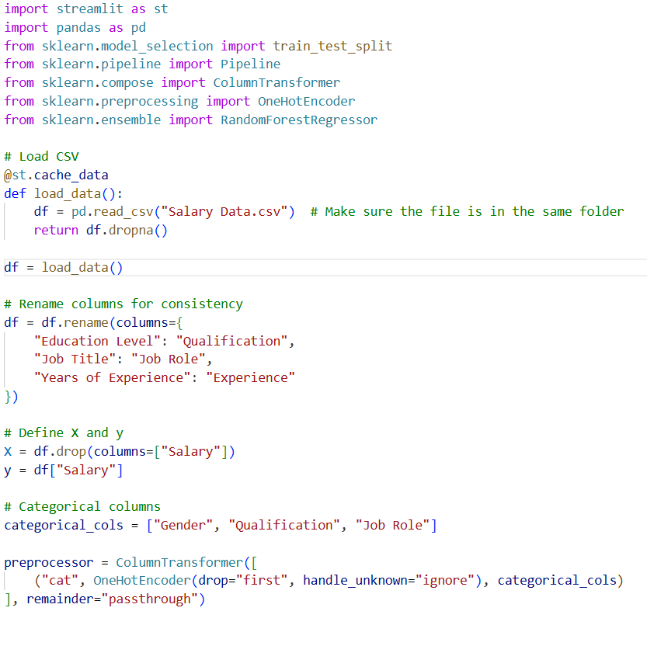
IMPLEMENTATION:

Slide 8
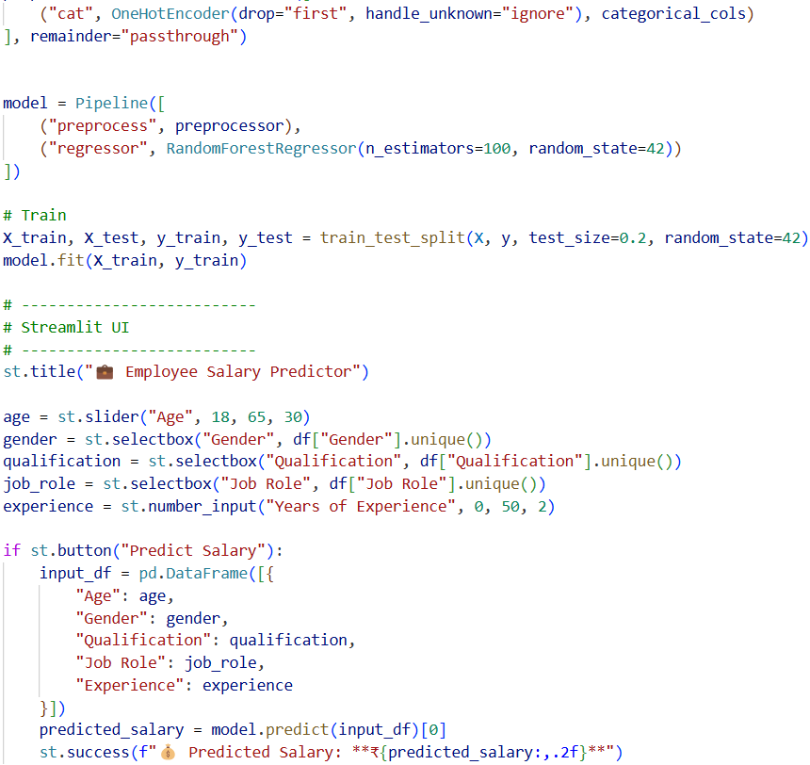

Slide 9
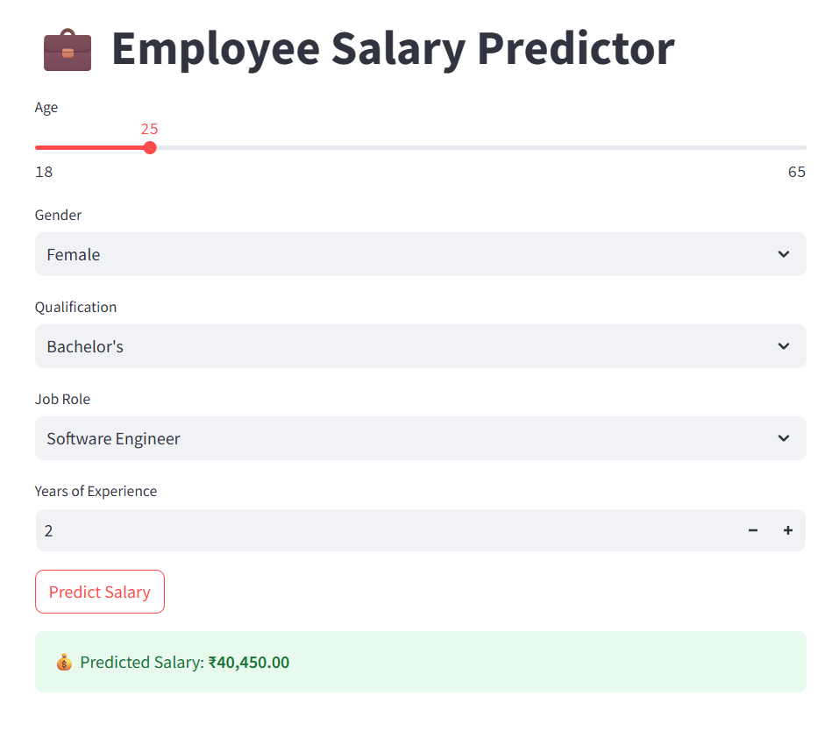
RESULT

Slide 10
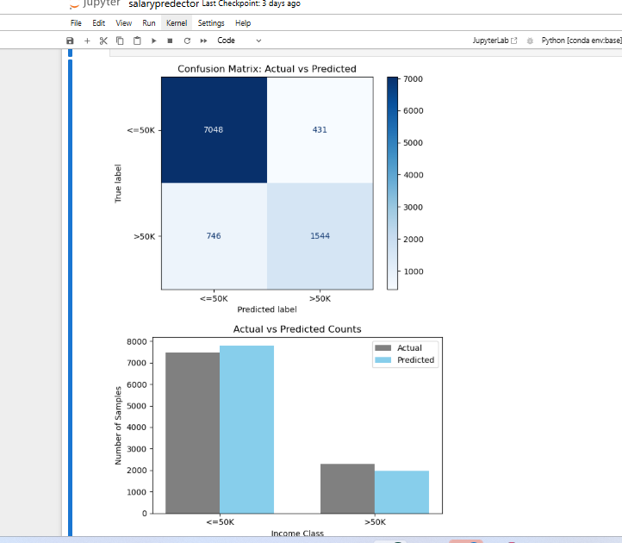
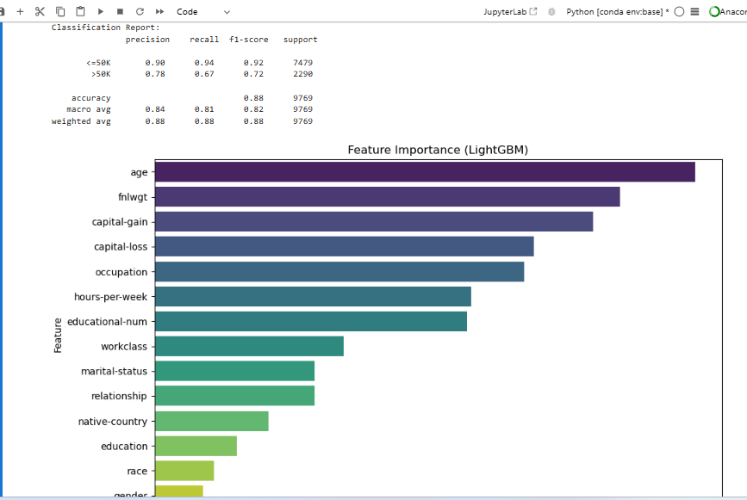
RESULT

Slide 11
RESULT
Git hub link: https://github.com/HemasreeKommula/employee-salary-prediction

Slide 12
Conclusion
The Employee Salary Prediction system successfully demonstrates the power of machine learning in automating and enhancing HR decision-making processes. By leveraging a Random Forest Regressor and Streamlit, we built an interactive and intelligent web application that predicts an employee’s salary based on key attributes like age, gender, qualification, job role, and experience.
This tool provides:
Quick and reliable salary estimation, reducing manual effort.
Data-driven insights that help organizations offer competitive compensation.
An intuitive interface for real-time predictions.
The solution is scalable, easy to deploy, and can be further enhanced with a larger dataset, additional features (e.g., industry, company size), or integration into HR systems.
.

Slide 13
References
Scikit-learn Documentation: https://scikit-learn.org
Streamlit Docs: https://docs.streamlit.io

Slide 14
THANK YOU

